Slide 1
TeamCity Powerful Continuous Integration out of the box

Slide 2
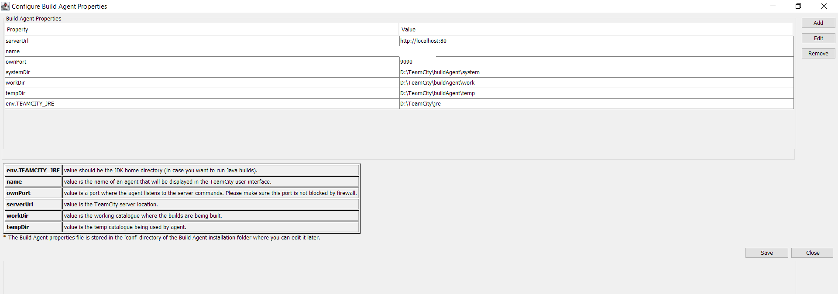
TeamCity Installation Go to the https://www.jetbrains.com/teamcity/download/ and choose a needed package (.exe for the Windows). Run the executable file and follow the installation instructions. You have options to install the TeamCity web server and one build agent that can be run as a Windows service.

Slide 3
TeamCity Access
If you did not change the default port (80) during the installation, the TeamCity web UI can be accessed via http://localhost/ in a web browser running on the same machine where the server is installed. Please note that port 80 can be used by other programs (e.g. Skype, or other web servers like IIS). In this case you can specify another port (88, for example) during the installation and use http://localhost:<port>/ address in the browser.

Slide 4
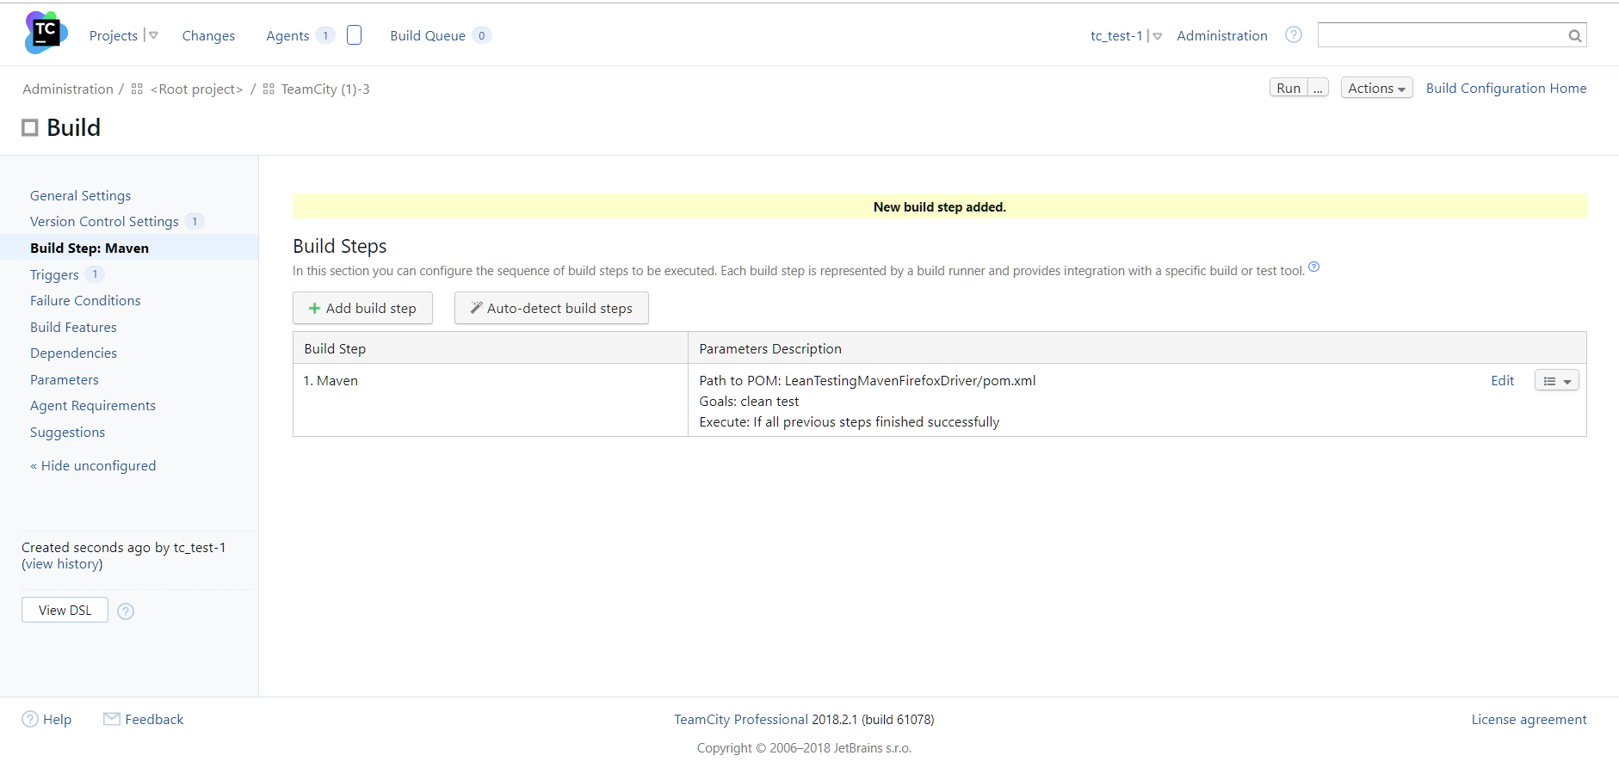
TeamCity Project Creation Go to the Administration Section and click Create Project Button. Choose “From a repository URL” (Supported formats: http(s)://, svn://, git://, etc. as well as URLs in Maven format.) or “Manually”. After choosing “From a repository URL” wait for “Auto-detected Build Steps”, check checkboxes and click Use selected Button.

Slide 5
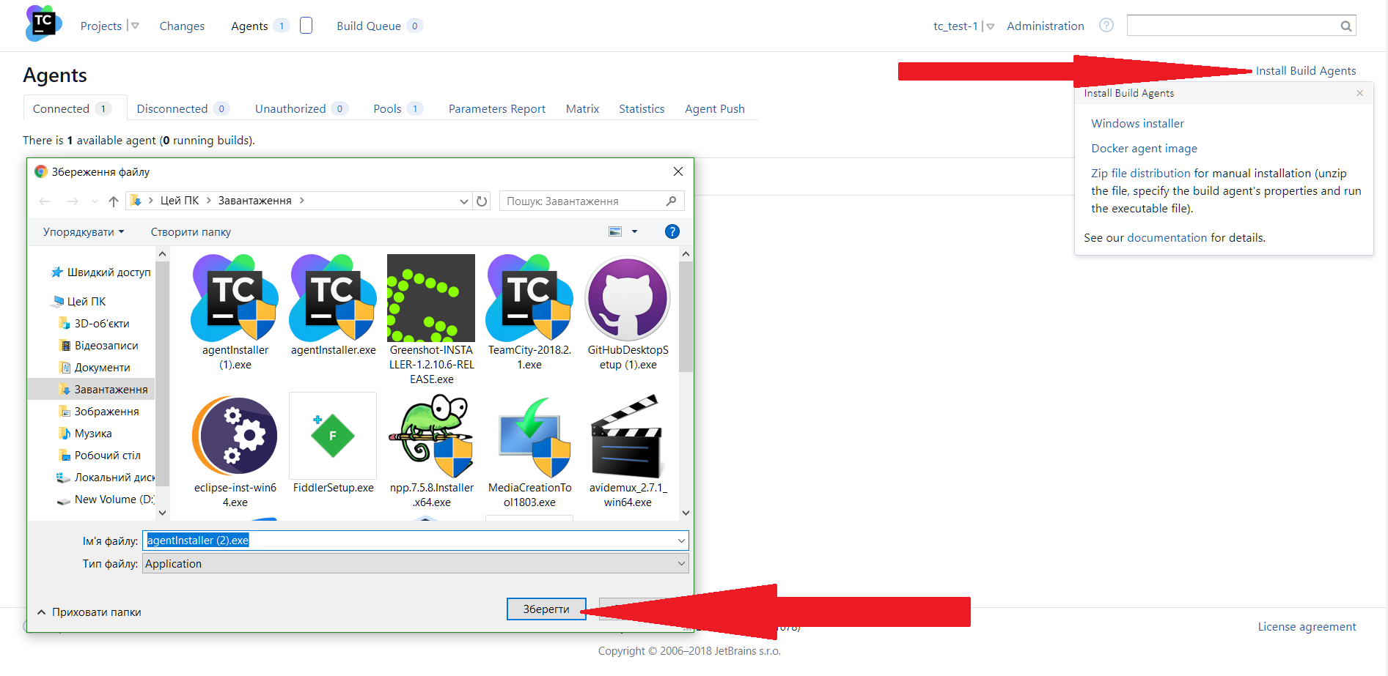
Build Agents Installation Installing via Windows installer In the TeamCity Web UI, navigate to the Agents tab. Click the Install Build Agents link and select MS Windows Installer to download the installer. Run the agentInstaller.exe Windows Installer and follow the installation instructions.

Slide 6
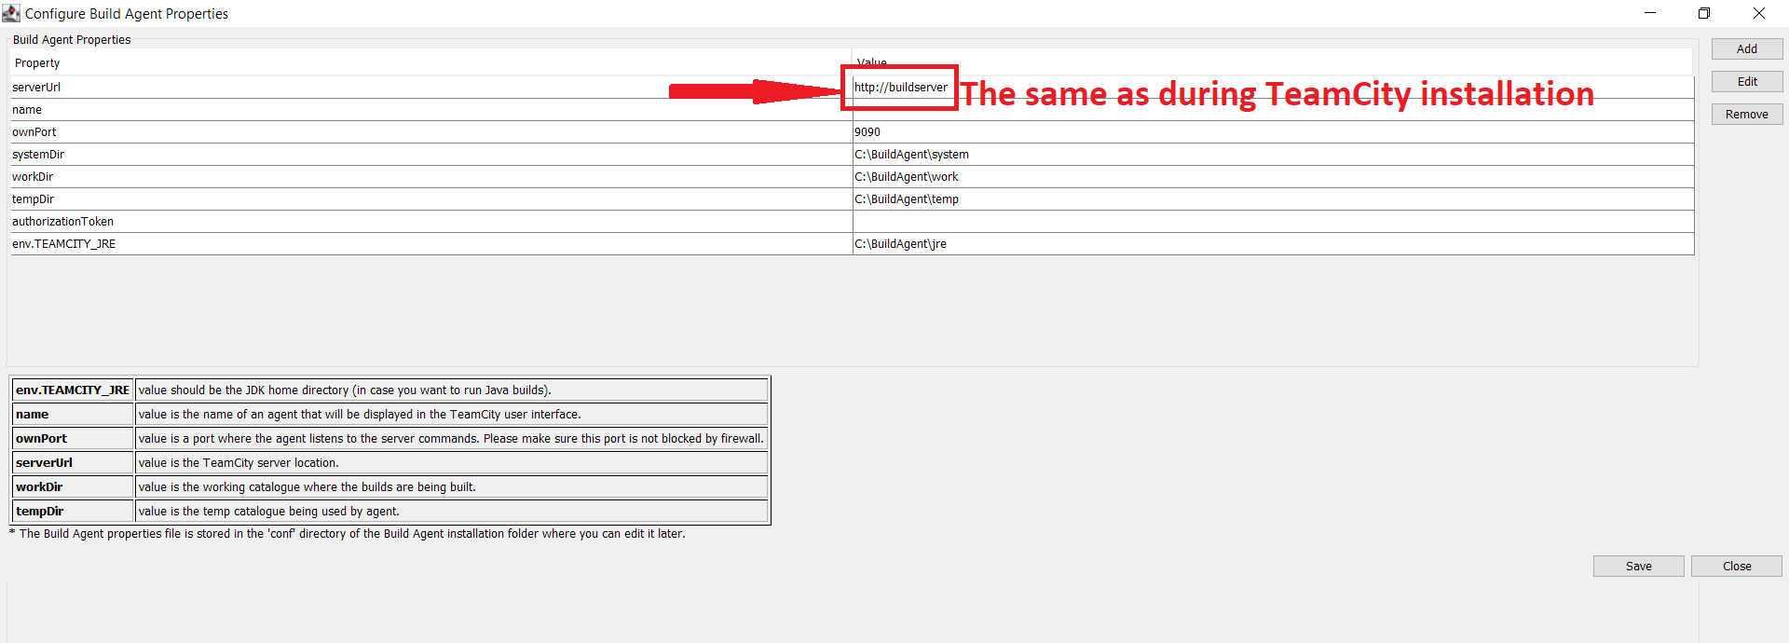
Build Agent Properties Configuration After running the agentInstaller.exe wait for the Build Agent Properties Configuration Window. Enter the same serverUrl as during the TeamCity installation.

Slide 7
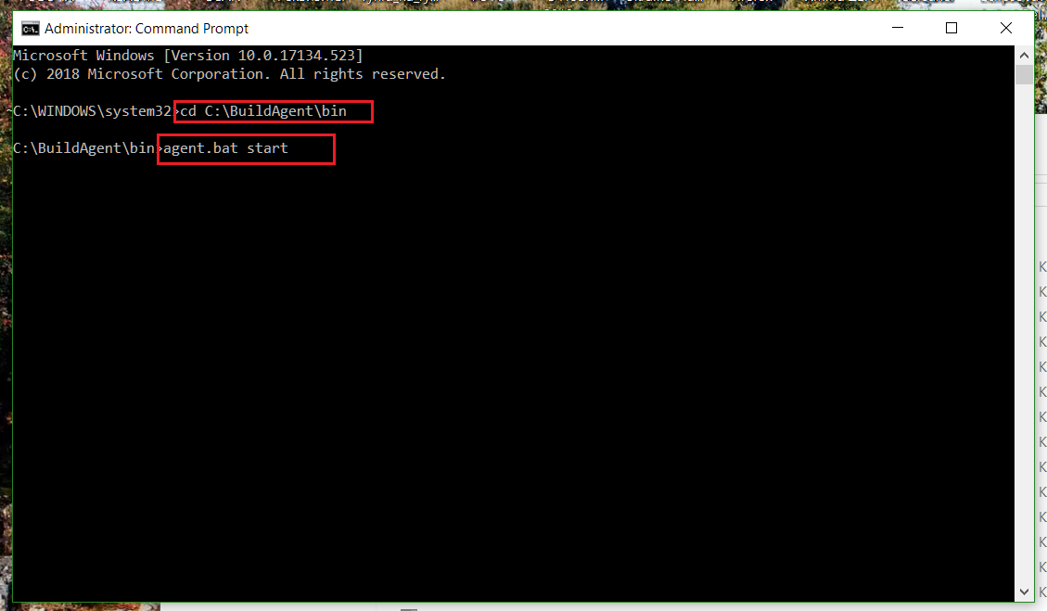
Starting the Build Agent TeamCity build agents can be started manually or configured to start automatically. Manual Start To start the agent manually, run the following script: for Windows: <installation path>\bin\agent.bat start

